Slide 1
Linguistics 201
Phonology 5
F. Torreira

Slide 2
Logistics
New Assignment 2 deadline: Feb 10
Quiz 2 today from 5 pm, open for 48 h
Reminder: Midterm exam on Feb 22 covers Phonetics and Phonology units
Morphology will be tested on final exam

Slide 3
Building syllables
‘squirms’ σ σ
R
O O N C N
s k w ɪ ɹ m z
extrasyllabic consonants

Slide 4
Today
Formalizing phonological processes:
Natural classes
Rules
Derivation tables

Slide 5
Natural Classes
Natural Classes are groups of sounds with similar phonological properties
All and only the sounds with those properties in a language
For instance, if analyzing English data:
/ p t k / all voiceless stops
/m n ŋ / all nasals
/m p b / all bilabial consonants
/i ɪ ʊ u/ all high vowels

Slide 6
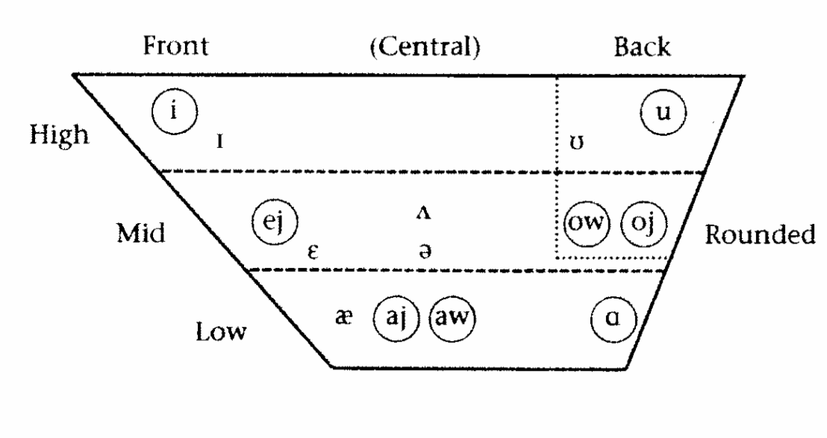
Natural Classes
We can refer to phonemic inventories in terms of manner, place of articulation, voicing, vowel height and frontness, kip rounding, etc.
High vowels
Alveolar consonants

Slide 7
Additional natural classes
Certain natural classes require further specification:
Linguists have found them to be useful when modelling the phonology of languages:
Consonants
All consonants
Opposite of vowels
Obstruents
Obstruent sounds involve a constriction in the vocal tract
i.e. stops, fricatives, and affricates
Opposite of sonorants
Liquids
Lateral and rhotic (r-like approximants)
Glides
Vowel-like approximants e.g. /j/, /w/

Slide 8
Some consonantal natural classes
Stops
Fricatives
Nasals
Laterals
Vowels
LING201 Winter 2021 Emily Goodwin

Slide 9
Some consonantal natural classes
Obstruent vs Sonorant: constriction in the vocal tract
Obstruents
Stops
Affricates
Fricatives
Nasals
Sonorants
Laterals
Glides
Rhotics
Vowels
LING201 Winter 2021 Emily Goodwin

Slide 10
Some consonantal natural classes
Approximant: partial constriction without turbulence
Stops
Affricates
Fricatives
Nasals
Approximants
Laterals
Glides
Rhotics
Vowels
Liquids
LING201 Winter 2021 Emily Goodwin

Slide 11
Some consonantal natural classes
Obstruents
Stops
Affricates
Fricatives
Nasals
Approximants
Sonorants
Laterals
Glides
Rhotics
Vowels
Liquids
LING201 Winter 2021 Emily Goodwin
Notes:
status of laterals/ rhotics- are we learning these categories and what counts as a ‘rhotic’ or a ‘lateral’ (here i am collapsing the lateral fricatives and lateral approximants)
Also liquid vs glide

Slide 12
Natural Classes
Phonological processes often involve natural classes
Examples from English:
All voiceless stops /ptk/ become aspirated at the beginning of a syllable that is word-initial OR stressed
All liquids /lɹ/ become voiceless after voiceless stops occurring at the beginning of syllables that are word-initial OR stressed
Using natural classes allows to make useful generalizations

Slide 13
Which of these is NOT a natural class in English?
/k g ŋ w/
/l ɹ s/
/i ɪ ej ɛ æ/

Slide 14
Which of these is NOT a natural class in English?
/k g ŋ w/
/l ɹ s/
/i ɪ ej ɛ æ/
Velar consonants
Front vowels

Slide 15
Natural Classes
Natural classes help us describe the phonological patterns and processes
One way to describe natural classes is with binary features, where segments are seen as bundles of features:
e.g. nasal mid and low vowels:
- consonantal
+ nasal
- high
We will NOT be using feature notation
We WILL refer to natural classes using single quotes e.g. ‘low nasal vowels’

Slide 16
Underlying and surface representations
Assumption in generative phonology: every morpheme (e.g. the word eat) has only one underlying representation
Underlying representations contain phonemes:
e.g. eat /it/
Underlying representations will be pronounced variably depending on the phonological rules of the language
e.g. eat /it/ could be pronounced [it] , [iɾ] , [it^{h}], etc. depending on context
Notes:
Gen. phonology assumes each morpheme/word in the lexicon has one unique phonological form, and that the the different allophonic variants are derived by means of rules
Not in all phonological models, exemplar models may assume more direct mapping between lexicon and pronunciation

Slide 17
Phonological rules
Underlying (phonological) representations are composed of phonemes
e.g. /itənæpl̩/
Surface (phonetic) representations are made out of allophones
e.g. [iɾənæpl̩]
Phonological rules derive surface representations from underlying representations
e.g. flapping rule: /t/ is realized as [ɾ] intervocalically between a stressed and unstressed vowel
See list of North-American English phonemes & allophones on myCourses

Slide 18
Underlying and surface representations
underlying
surface
What rules predict the realization of English /l/?
See examples of common phonological rules in North-American English
Notes:
For instance, our analysis of English: it only has one voiced lateral consonant phoneme present in the UR of many words

Slide 19
Phonological rules
Describe where different variants of a sound occur formally
Formalization avoids ambiguity
can be exploited computationally
Some useful symbols
C = consonant
V = vowel
# = word boundary
σ[ and ]σ = left and right syllable boundaries

Slide 20
Rule format
A → B / X _ Y
This means:
XAY is pronounced as XBY
A is pronounced as B when preceded by X and followed by Y

Slide 21
Rule format
A → B / X _ Y
A is the affected segment or input
B is the output that the rule creates
X _ Y is the context or conditioning environment of the rule
In many rules (not the one above), only X or only Y are specified, not both

Slide 22
Flapping
In English, coronal/alveolar stops become flaps between two vowels, where the second vowel is unstressed:
 | [swit] | sweet |  | [ˈswiɾɚ] | sweeter
 | [ʃʊt] | shoot |  | [ˈʃʊɾɚ] | shooter
 | [swɛt] | sweat |  | [ˈswɛɾɪŋ] | sweating
 | [fid] | feed |  | [ˈfiɾɚ] | feeder
 | [fud] | food |  | [ˈfuɾi] | foodie
 | [əˈtɑmək] | atomic |  | [ˈæɾəm] | atom
/t / /d/
[ɾ]
/t/ and /d/ are neutralized when the flapping rule applies
They become undistinguishable in flapping environments

Slide 23
Example
Flapping in North-American English
Coronal stops /d, t/ become flaps between stressed and unstressed vowels.
A → B / X _ Y
/t, d/ →
input

Slide 24
Example
Flapping in North-American English
Coronal stops /d, t/ become flaps between stressed and unstressed vowels.
A → B / X _Y
/t, d/ → [ɾ]
output

Slide 25
Example
Flapping in North-American English
Coronal stops /d, t/ become flaps between stressed and unstressed vowels.
A → B / X _Y
/t, d/ → [ɾ] / 'stressed vowel' _ 'unstressed vowel’
conditioning environment

Slide 26
Example rule
A good rule description has 3 parts: a useful name, a prose description, and the rule itself:
Name: Flapping
Description: Coronal stops /d, t/ become flaps between stressed and unstressed vowels
Rule: /t, d/ → [ɾ] / 'stressed vowel' _ 'unstressed vowel’

Slide 27
Canadian raising
In Canadian English, [aj, aw], and [ʌj, ʌw] appear to be in complementary distribution
What triggers the alternation?
[ʌj] and [ʌw] occur before voiceless consonants
[aj], [aw] occur elsewhere
Phonemes and elsewhere allophones match:
We will now define a rule that derives [ʌj] and [ʌw] from /aj/ and /aw/ before voiceless consonants
[flaj] | ‘fly’
[drajv] | ‘drive’
[majl] | ‘mile’
[tajm] | ‘time’
[rawz] | ‘rouse’
[dawn] | ‘down’
[nʌjs] | ‘nice’
[mʌws] | ‘mouse’
[rʌjt] | ‘write’
[pʌwt] | ‘pout’
[rajd] | ‘ride’
[lawd] | ‘loud’
Notes:
ask to figure out what the environments are

Slide 28
Canadian raising
Description: /aj/ and /aw/ are raised (become [ʌj] and [ʌw]) before voiceless consonants
Rule: /aj, aw/ → [ʌj, ʌw] /_ ‘voiceless consonants’
Reminder: No rule needed to derive [aj] and [aw] (‘elsewhere allophones’)
[flaj] | ‘fly’
[drajv] | ‘drive’
[majl] | ‘mile’
[tajm] | ‘time’
[rawz] | ‘rouse’
[dawn] | ‘down’
[nʌjs] | ‘nice’
[mʌws] | ‘mouse’
[rʌjt] | ‘write’
[pʌwt] | ‘pout’
[rajd] | ‘ride’
[lawd] | ‘loud’
Notes:
ask to figure out what the environments are

Slide 29
Derivation tables
Canadian Raising
/aj aw/ → [ʌj ʌw] /__ voiceless consonants
 | ‘mice’ | ‘time’
UR
Rule
Output
Useful way of testing if rule applies correctly across different contexts

Slide 30
Derivation tables
Canadian Raising
/aj aw/ → [ʌj ʌw ] /__ voiceless consonants
 | ‘mice’ | ‘time’
UR | /majs/ | /tajm/
Rule
Output

Slide 31
Derivation tables
Canadian Raising
/aj aw/ → [ʌj ʌw ] /__ voiceless consonants
 | ‘mice’ | ‘time’
UR | /majs/ | /tajm/
Canadian raising
Output

Slide 32
Derivation tables
Canadian Raising
/aj aw/ → [ʌj ʌw ] /__ voiceless consonants
 | ‘mice’ | ‘time’
UR | /majs/ | /tajm/
Canadian raising | [mʌjs]
Output | [mʌjs]
applies

Slide 33
Derivation tables
Canadian Raising
/aj aw/ → [ʌj ʌw ] /__ voiceless consonants
 | ‘mice’ | ‘time’
UR | /majs/ | /tajm/
Canadian raising | [mʌjs] | ⎯
Output | [mʌjs] | [tajm]
rule doesn’t apply before voiced consonants

Slide 34
Derivation tables
Canadian Raising
/aj aw/ → [ʌj ʌw ] /__ voiceless consonants
 | ‘mice’ | ‘time’
UR | /majs/ | /tajm/
Canadian raising | [mʌjs] | ⎯
Output | [mʌjs] | [tajm]

Slide 35
Canadian raising
Rule name: Canadian raising
Prose description: /aj/ and /aw/ are raised before voiceless consonant
Formal rule: /aj, aw/ → [ʌj, ʌw] / __ voiceless consonant

Slide 36
Phonology wrap-up
Skills to acquire:
How to identify whether phonetically-similar surface allophones belong to the same or different phonemes
In English, [p] and [p^{h}] are allophones of the same phoneme /p/
How to build syllables following general template
Make sure to satisfy all syllabification principles
How to describe phonological processes in prose, using natural classes when possible
Natural classes: All and only all sounds with particular property / properties in a language
How to write simple rules formally, referring to natural classes when possible
Format: A → B / X _Y
How to evaluate rules by means of derivation tables

